Slide 1
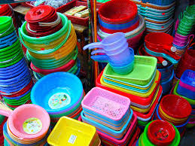
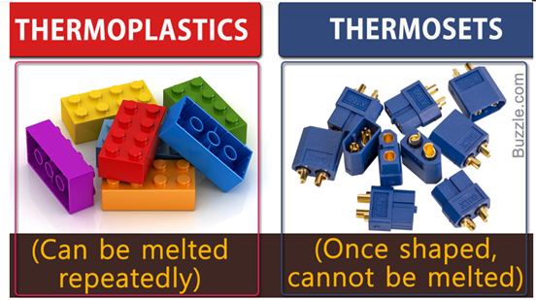
ENGINEERING POLYMER
Chemistry Lecturer
Sambridhi Shah

Slide 2
Course Contents:
Polymers
Inorganic Polymers
Organic Polymers

Slide 3
POLYMERS:
Definition
Natural and Synthetic polymers
Homo polymers and Co- polymers

Slide 4
Definition of Polymers:
Greek word; Poly- many; Meros- parts (Polymers- Many parts)
Polymers are the large molecules formed by the combination of many small molecules.
Small molecules – Monomers
Process- Polymerization
Products- Polymers
Example,
Polymerization
Monomers Polymers
Polymerization
nCH₂ = CH₂ ( – CH₂ – CH₂ – )_{n}
Ethene (monomer) Polythene (polymer)

Slide 5
Classification of Polymers:
On the basis of origin ( Natural & synthetic polymers )
On the basis of monomers ( Homopolymers & co- polymers)

Slide 6
Natural & synthetic polymers:
Natural polymers:
Synthetic polymers:
Occurs in nature ( in plants and animals bodies in different forms)
Examples; proteins, starch, cellulose, rubber etc.
Synthesized from different compounds ( in lab )
Examples; polythene, bakelite, polyvinyl chloride (PVC), nylon, teflon, polystyrene,

Slide 7
Homopolymers & co- polymers:
Homopolymers:
Co- polymers:
Contains only one type of monomer unit.
Example;
polythene (– CH₂ – CH₂ –)_{n}
PVC (– CH₂ – CHCl –)_{n}
Contains more than one type of monomer units.
Examples;
Bakelite
Nylon 66

Slide 8
A. Organic Polymers
Those polymers which are formed by the combination of carbon atoms are called organic polymers.
Examples: PVC, Bakelite, TEFLON, etc.
Types of organic polymers
On the degree of polymerization, the organic polymers are:
Additional Polymers
Condensation Polymers
Plastic Polymers

Slide 9
Types of organic polymers
Condensation Polymers
Additional Polymers
Plastic Polymers
Formed by the addition of monomers.
Also called chain polymers
Due to the application of heat, light, the catalyst for breaking down of covalent bond of monomers.
Formed after the condensation of monomers.
Monomers combine through condensation reaction by eliminating simple molecules such as H₂O, NH₃, HCl as products.
Polymers have high molecular weight. And can be moulded into any desired form when subjected to heat and pressure in the presence of a catalyst.
TYPES
A) Thermoplastic polymer
B) Thermosetting polymer

Slide 10
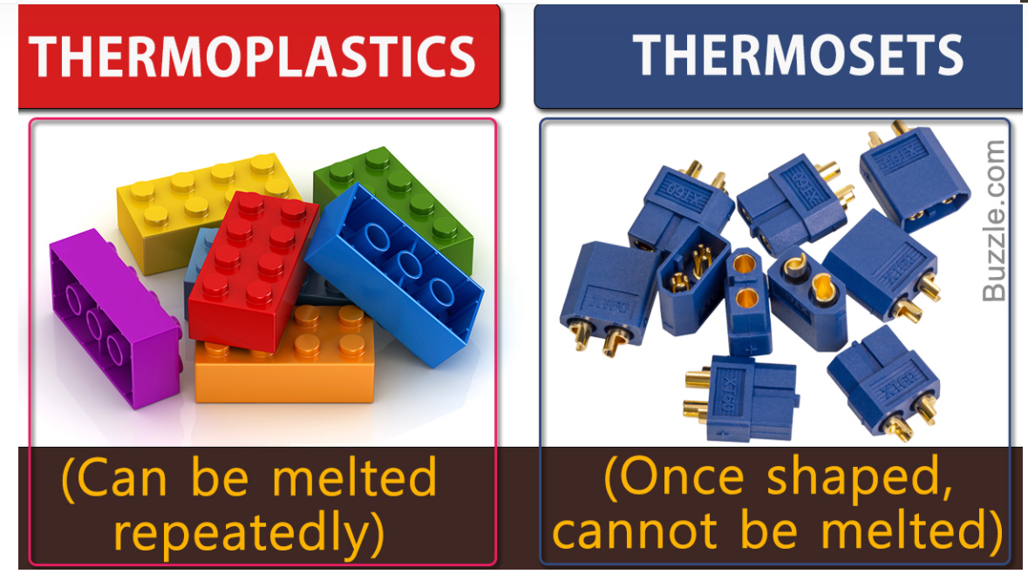
Plastic Polymers
Thermoplastic polymer
Thermosetting polymer
These polymers are produced by addition polymerization.
They have a linear molecular structure.
They are easily soften on heating. So, they can be remoulded.
Generally, they are soft, weak, and less brittle.
They are soluble in an organic solvent.
Examples: polyethylene, PVC (hard thermoplastic polymer).
These polymers are produced by condensation polymerization.
They have 3-dimensional molecular structure.
They don’t soften on heating. But, they get hard on heating.
Generally, they are hard, strong and more brittle.
They are insoluble in organic solvent
Example: Bakelite.

Slide 11
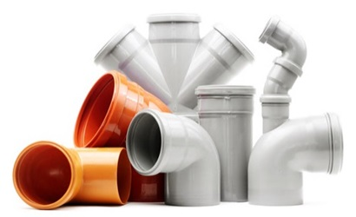
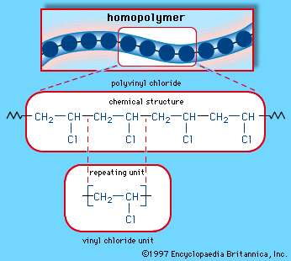
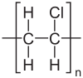
PVC:
Polyvinyl chloride
IUPAC name: poly – (1-chloroethylene)
Monomer: vinyl chloride (CH₂=CHCl) ( heated in an
inert solvent with dibenzoyl peroxide (ArCO)₂O_{2.}
Synthetic polymer, homopolymer, addition polymer
Preparation;
Used in the manufacture of artificial leather, floor covering, table clothes, rain coats, cable insulators etc.
polymerization
nCH₂ = CHCl
Benzoyl peroxide
Chloroethene PVC

Slide 12
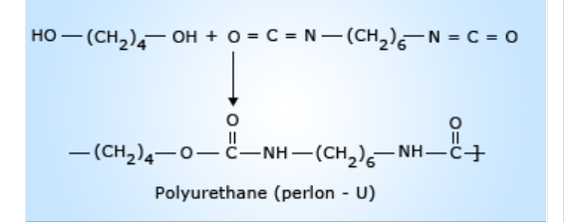
Preparation and application of organic polymer
Polyurethanes
It is prepared by reacting the monomer diisocyanate and diol. It is a synthetic polymer and the process is additional polymerization.
For example, Perlon- U is prepared by the action of 1,4 butane-diol with 1,6-hexadiisocyanate.

Slide 13

1. Polyurethanes
Uses
They are used as layer coating.
They are used in the garment industry.
They are used as synthetic leather.
They are used to produce or manufacture different types of utensils.

Slide 14
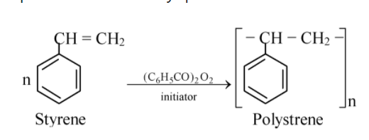
2. Polystyrene or Styron
It is prepared by free radical polymerization of styrene in presence of Benzoyl peroxide.

Slide 15
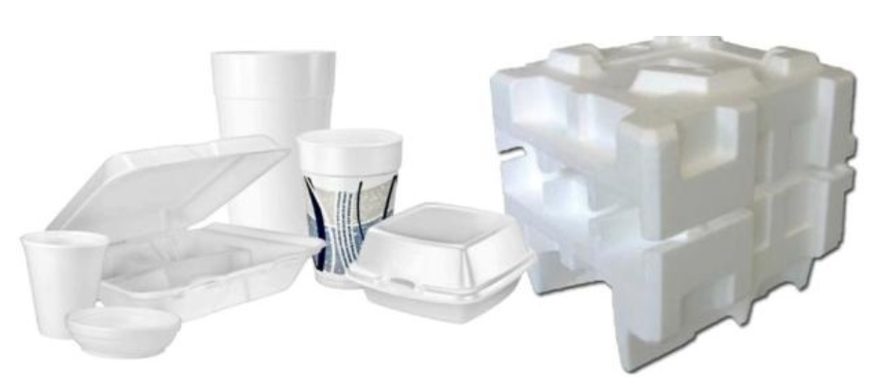
2. Polystyrene or Styron
Uses
It is used to form containers from food materials.
It is used for making hot drink cups, different types of toys, comb, household articles, etc.
It is used to manufacture tiles for the floor.

Slide 16
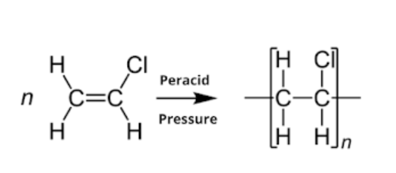
3. Polyvinyl chloride (PVC)
It can be prepared by heating vinyl chloride in presence of peroxide at 60-80 ˚C between 1 – 1.5 atm pressure.
It is hard thermoplastic polymer.

Slide 17
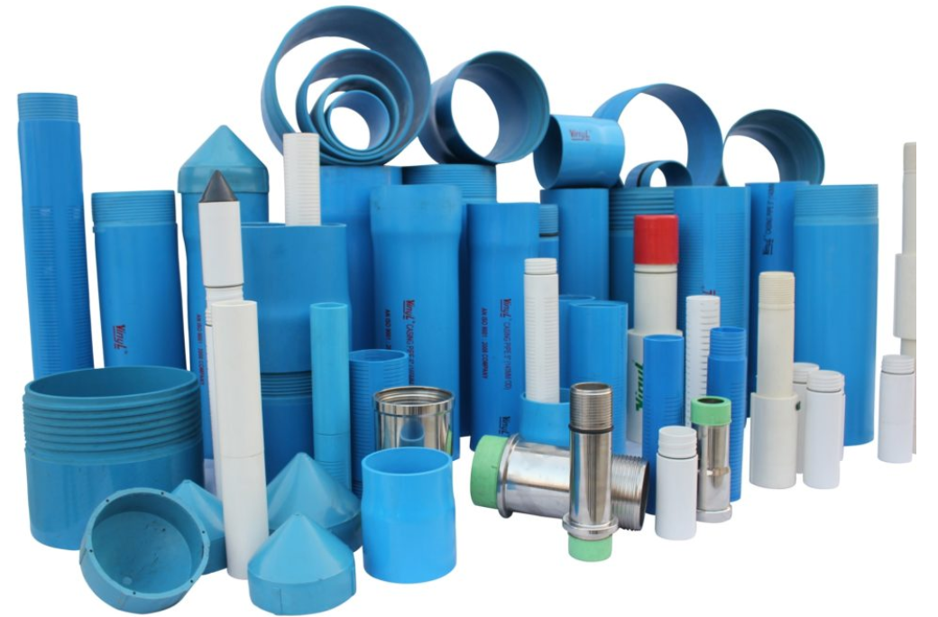
A) Unplasticized PVC i) They are used for manufacturing tank, helmet, refrigerator components. ii) They are used for manufacturing tyres of cycles and motorcycles, etc.
3. Polyvinyl chloride (PVC)
It is used as unplasticized and plasticized PVC
b) Plasticized Pvc
They are used for manufacturing raincoats, handbags, curtains, clothes, toys, table cloths, belts, etc.
they are used for artificial flooring.
They are also used to prepare insulating materials for wires and other electrical goods.

Slide 18
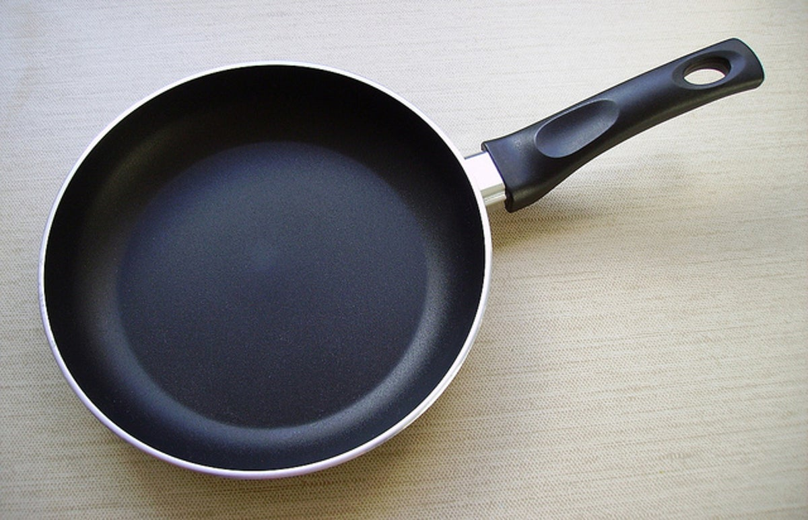
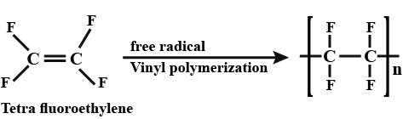
4. Teflon:
Polytetrafluoroethene (PTTE)
Monomer: Tetrafluoroethene (CF₂ = CF₂)
Synthetic polymer, homopolymer, addition polymer
Inert polymer; resist the action of acids, alkalies, oxidizing agents, high temperature, smooth and soft and bears antistick properties.
Preparation;
Used in the manufacture of gaskets, valves, non-lubricated bearings, non stick pans and other utensils, insulators etc.

Slide 19
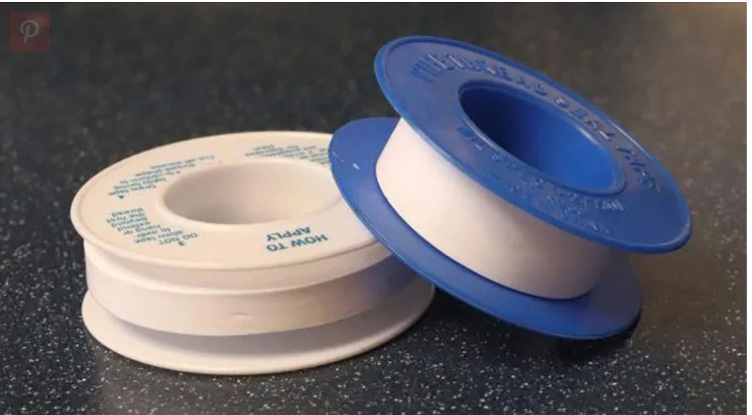
4. Teflon
Uses
It is used for manufacturing materials for motor, transformer, cable, wire, etc.
It is used for making gaskets.
It is used for making Sloppers in the burette.
It is used as a coating asbestos

Slide 20
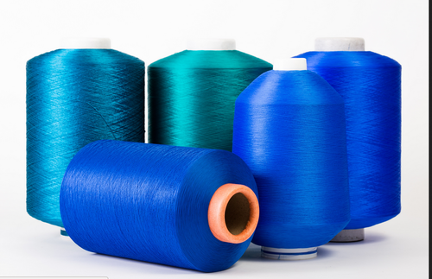
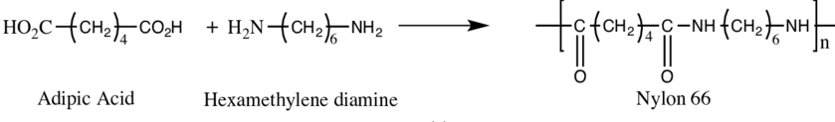
5. Nylon 66:
Monomers: Adipic acid [HOOC – (CH₂)₄ – COOH] &
Hexamethylenediamine [H₂N – (CH₂)₆ – NH₂].
Synthetic polymer, co-polymer, condensation polymer.
Extremely strong threads or fibres which are chemically inert.
Preparation;
Used in the manufacture of woolen garments, clothes, ropes, tennis rackets, fishing nets etc.

Slide 21
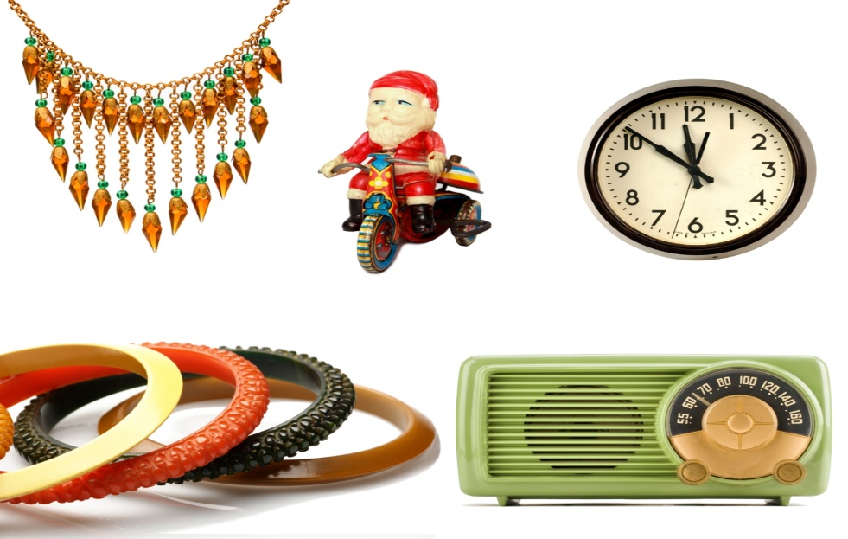
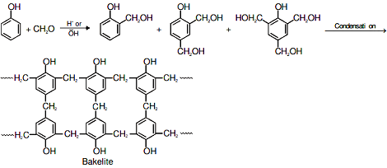
6. Bakelite:
Monomers: Phenol (C₆H₅OH) & Formaldehyde (HCHO)
Synthetic polymer, co-polymer, thermosetting polymer.
Extremely low electrical conductivity and extremely high heat resistance plastic with high strength.
Preparation;
the

Slide 22
6. Bakelite
Uses
Used in manufacturing electric insulators like the switch, plug, heater handle, etc.
Used to make body parts of telephone, TV, radio, etc
Used in paints and variable varnish.
Used to make parts of airplane craft.
Used to make a handle of utensils which are used for heating purposes.

Slide 23
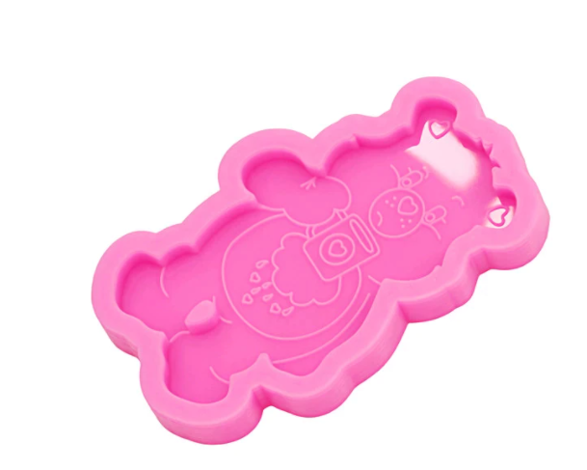
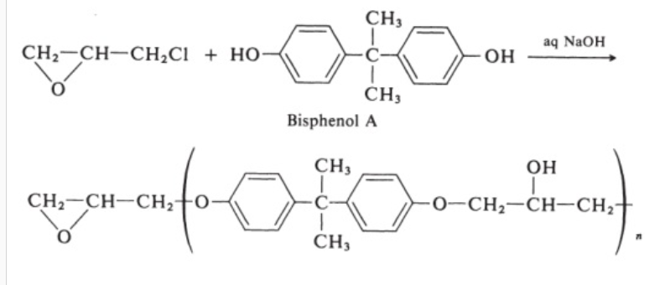
7. Epoxy resins
It is a condensation polymer obtained by the combination of bisphenol and epichlorohydrin. It is three-dimensional cross-linked polymer.

Slide 24
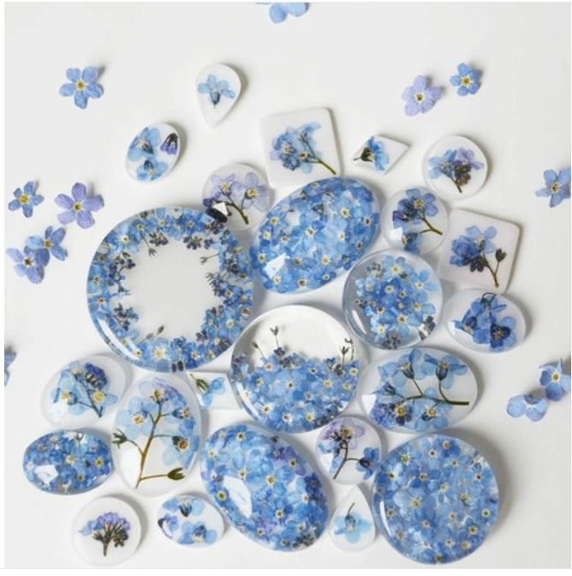
7. Epoxy resins
Uses
As a surface coating, adhesive like Araldite (for glass, metals, etc), glass-fiber-reinforced polymers.
For skid-resistance surface for highway
For the production of components for aircraft and automobiles.
As lamination materials used in electrical equipment's.
Epoxy resins are applied over cotton, rayon, and bleached fabrics to impart creases resistant and shrinkage control.

Slide 25
8. Fiber Reinforce plastics (FRP)
Fiber-reinforced plastic is a composite material made by polymer matrix reinforced and fiber. The polymer matrix used in FRP is usually an epoxy resin, polyester, and phenol-formaldehyde. Similarly, fibers used in FRP are glass, carbon, and aromatic polyamide. In FRP, some filler substances like sawdust, asbestos, marble powder, carbon alumina and china clay etc, are added to impart better properties to the polymer. These fillers, improve the thermal stability, insulating character, rigidness, hardness, brittleness, and workability, etc. The properties of the final reinforced composite material i.e., FRP are determined by the nature of fibers used.

Slide 26
8. Fiber Reinforce plastics (FRP)
Characteristics
Stability power is high.
Corrosion resistance.
Non-inflammability.
Low cost of production.
High strength to weight ratio.
Ability to form complex shapes.
Low coefficient of thermal expansion.
Neither shrink nor stretch.

Slide 27
8. Fiber Reinforce plastics (FRP)
Uses
They are used to make doors, windows, chairs, and camera housing parts.
To make acid storage tank.
To make pistol grips and rifle.
To make wires, switches, exhausts fan of computer.
To make wall panels and pipes, etc.

Slide 28
Concept of biodegradable, non-biodegradable, and conducting polymer
Biodegradable Polymer
Those polymers which are decomposed in natural, aerobic, and anaerobic environments are called biodegradable polymers.
Bio-degradation of polymer can be achieved by the ability of micro-organisms in the environment to metabolize the molecular structure.
The use of biodegradable polymer is that they are used in the biotic environment.
Some examples of biodegradable polymer is; polylactic acid, polybutylene succinate, polyanhydride, polyvinyl alcohol, starch derivative cellulose., etc.

Slide 29
Biodegradable Polymer
Application of biodegradable polymer
They are used in the biomedical field.
They are used in the agricultural field for making fertilizer.
They are used in waste management.

Slide 30
B) Non- Biodegradable Polymer
Don’t undergo degradation/decomposition due to exposure to oxygen, ozone, moisture, heat, radiation, microorganism.
Example: Epoxy resin, polyurethane, etc
They are not decomposed by micro-organisms or another biological factor.
Most of the synthetic polymers are non-biodegradable polymers.
Example: Xylon, nylon, polyester, etc.

Slide 31
C) Conducting Polymer
In most of the polymers due to the lack of free electrons, they are poor conductors of electricity.
But within the past few years, polymers have been synthesized which possess electrical conductivity.
They are also called conducting polymers.
Conducting polymers are categorized into 4 types:
ICP (Intrinsically conducting polymer)
DCP (Doped conducting polymer)
ECP (Extrinsically conducting polymer)
CCP (Coordination conducting polymer)

Slide 32
C) Conducting Polymer
1. ICP (Intrinsically conducting polymer)
ICP consists of a delocalized electron pair or residual charge due to which they conduct electricity.
Example: polyaniline, polypyrrole, polythiophene, etc.
2. DCP (Doped conducting polymer)
DCP is obtained by exposing a polymer to a charge transfer agent in a gas phase or in a solution phase.
Example: p-dopant, n-dopant.
3. ECP (Extrinsically conducting polymer)
Extrinsically conducting polymer conducts electricity due to the presence of externally added ingredients in them.
Some external gradients are carbon powder, metallic fiber, etc.

Slide 33
C) Conducting Polymer
4. CCP (Coordination conducting polymer)
CCP is produced by the combination of metal atom polydentate ligand (ligand which donates more than 2 electrons).
Example: Calcium and Magnesium complex.

Slide 34
Engineering application of conducting polymer
They are light in weight, easy to process, have good mechanical properties. So, they are used in rechargeable batteries, in an optical display device in aircraft, in telecommunication systems, in solar cells, in a transistor, diode, photovoltaic device, etc.,

Slide 35
B) Inorganic Polymers
The polymers are formed by the combination of atoms other than carbon in the main chain or backbone.
Elements like Si, N, P, S, etc.
The elements in inorganic polymers are joint together by single or double covalent bonds.
Example: Silicone, polyphosphazene, polysulphur nitride.

Slide 36
B) Inorganic Polymers
General properties
At a high temperature nearly above 600 ˚C, they only melt but don’t burn except sulfur containing polymers.
They are usually stiffer, harder, and more brittle as they form cross-linked structures.
With cross-linked structures, the chain segments between cross-links are usually short, but stiff or not flexible and they are enough to swell reversibly or intercalation of molecules of solvents.
They dissolve only in polar solvents.
They are stiffer in nature.

Slide 37
Classification of inorganic polymers
On the basis of element, present in monomers, they are classified as
Polyphosphazines
Sulphur based polymer
Silicones

Slide 38
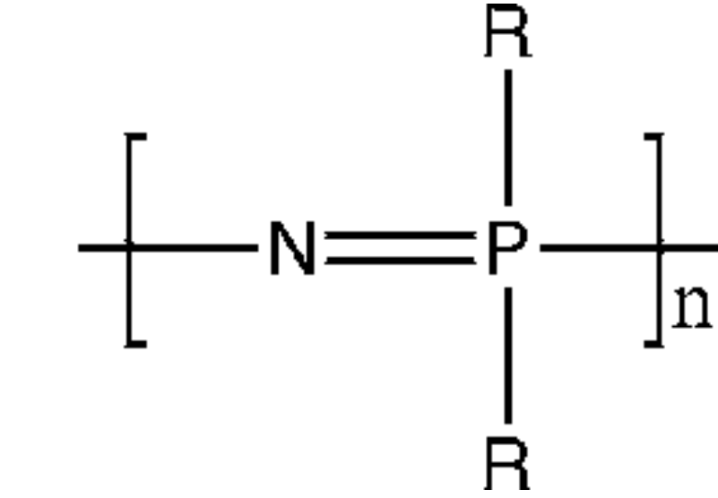
Preparation and applications of inorganic polymer
Polyphosphazines
The polymers which contain phosphorous atoms as central atoms of unit particles ate polyphosphazine.
Alternate nitrogen and phosphorous groups.
Also known as inorganic rubber
General formulae:
Where, R = -Cl in polyphosphonitrile chlorides
R = -OCH₃ in polydimethoxy phosphazines
R = -OC₂H₅ in polydiethoxy phosphazines

Slide 39
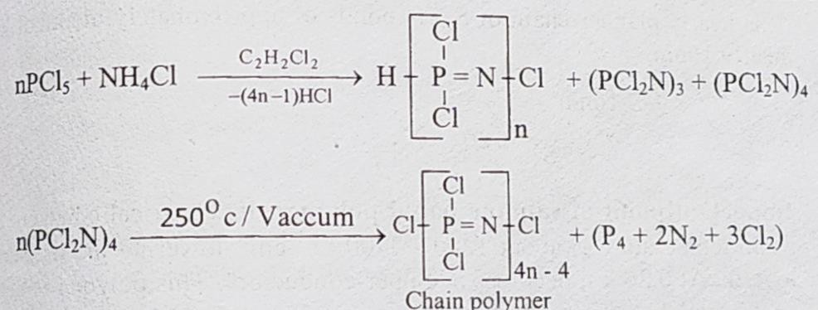
Polyphosphazines
Polyphosphonitrile chloride
They are prepared by reaction between phosphorus pentachloride and ammonium chloride in presence of C₆H₅Cl at 120-150˚C followed by heating cyclic tetramer in vacuum at 250 ˚C forming chain polymer.

Slide 40
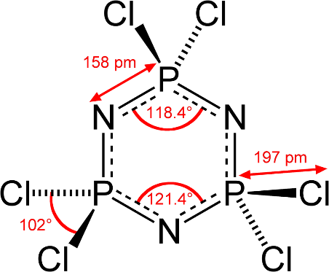
Polyphosphazines
Fig- Trimer (Cyclic phosphonitrillic chlorides)

Slide 41
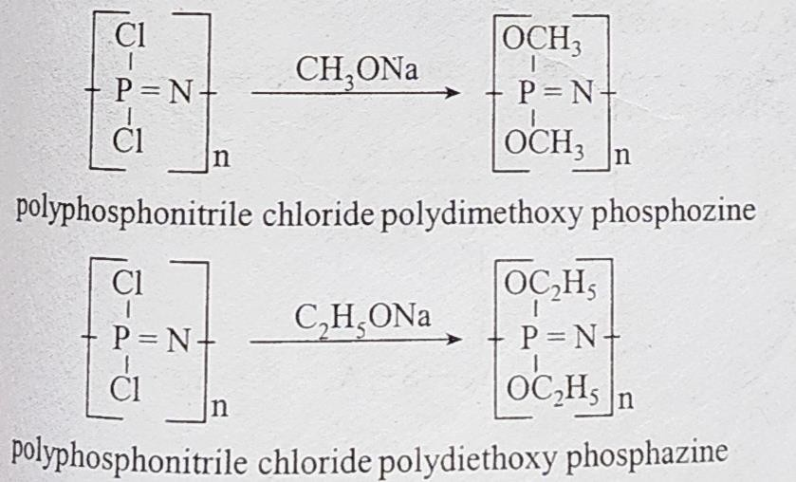
Polyphosphazines
b) Polydimethoxy phosphazines and polydiethoxy phosphazines
They are prepared by the reaction of phosphonitrile chloride with sodium methoxide and sodium ethoxide respectively.

Slide 42
b) Polydimethoxy phosphazines and polydiethoxy phosphazines
Uses
They are used as plastics necessary for making fuel hoses and baskets.
They are used as waterproof thermoplastics as they have water-repelling capacity.
They form foams and fibers and have lower electrical conductivity.

Slide 43
2. Sulphur based inorganic polymers
They are inorganic polymers containing Sulphur due to their catenation property. It has two categories:
Linear Chain Polymers:
Polymeric Sulphur (PS)
It is prepared by melting rhombic Sulphur (S8) at 165-168ºC followed by pouring of molten Sulphur into ice water. S8 is converted to free radical which in combination with S8 produces long chains. The solid product is washed with carbon disulphide to remove S8 which if present converts polymeric Sulphur to S8.

Slide 44
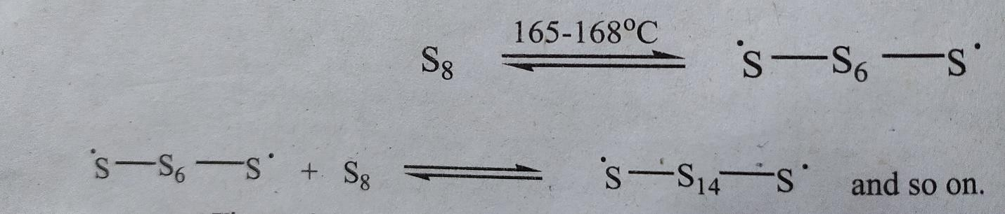
2. Sulphur based inorganic polymers
Polymeric Sulphur (PS)
It is unstable below the boiling point of Sulphur ie.114ºC and gets converted to rhombic Sulphur.
Uses
It is used as flame proofing fabrics are known as plasticizers.
It is as a catalyst in the silicones manufacturing process.

Slide 45
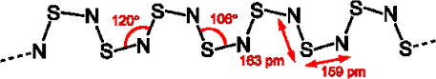
2. Sulphur based inorganic polymers
ii) Polymeric Sulphur nitride (SN)n
Polythiazyl is also known as polymeric sulfur nitride (SN)n is an electrically conductive gold-colored polymer with a metallic luster. S4N4 is the source for the preparation of (SN)n. At first disulphur dinitride is formed when S4N4 is vaporized at reduced pressure and passed through silver wool followed by its slow polymerization resulting in polythiazyl (SN)n.
It is soft, malleable, and golden bronze in color.
It gets moisturized slowly when left open.
It shows metallic conductivity and becomes a superconductor at 0.26 K so called as non-metallic superconductor.

Slide 46
2. Sulphur based inorganic polymers
ii) Polymeric Sulphur nitride (SN)n
Uses
It is used for the construction of the digital circuit, digital computer, transformer, electric motor, etc.

Slide 47
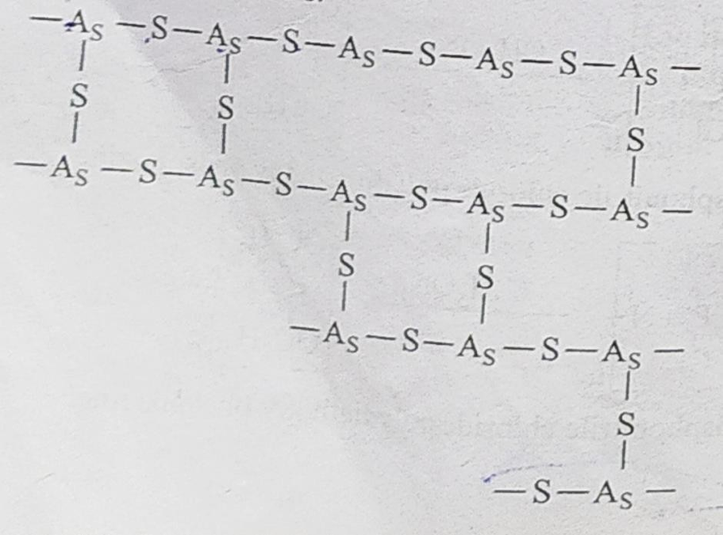
2. Sulphur based inorganic polymers
b) Chalcogenide glass or Network Polymers:
They are cross-linked amorphous polymers formed by reacting polyvalent elements like As, Ge, In, P, Sb, etc with chalcogens (S, Se, Te). It is prepared under conditions for minimizing oxidation and loss of volatilization. For eg- (SiS₂)n, (As₂S₃)n (best-known chalcogenide), etc.

Slide 48
2. Sulphur based inorganic polymers
b) Chalcogenide glass or Network Polymers:
They are stable to acid but not to concentrated alkalies.
They possess lower softening points and tensile strength.
They can be distilled without decomposition in vacuum.
They are coloured.
Switching is observed on them which is reversible change of conductivity from lower to higher state under applied voltage.

Slide 49
2. Sulphur based inorganic polymers
b) Chalcogenide glass or Network Polymers:
Uses
They are used in ultrasonic delay lines, high energy particle detector, a memory devices, electroluminescent displays.
Infrared transmitting windows are made from them.

Slide 50
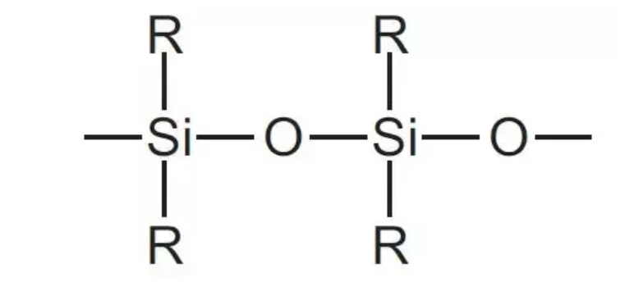
3. Silicones or Silicone Polymer
It is inorganic polymer which contains alternate silicon, oxygen linkage. Organic radicals are attached with silicon atom.

Slide 51
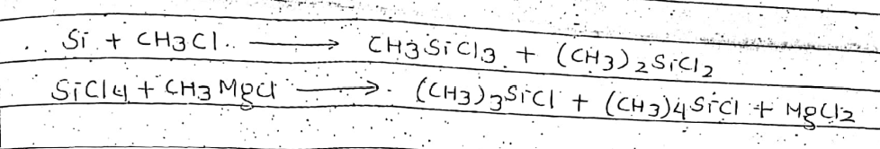
3. Silicones or Silicone Polymer
Preparation:
It is prepared by reacting alkyl halide or by reacting silicon halides with Grignard’s reagent.
These polymers are prepared by the fractional distillation method

Slide 52
3. Silicones or Silicone Polymer
Types of Silicon polymers
Monomethyl silicon trichoride – CH₃SiCl₃
Dimethyl silicon dichloride (CH₃) ₂SiCl₂
Trimethyl silicon chloride (CH₃) ₂SiCl

Slide 53
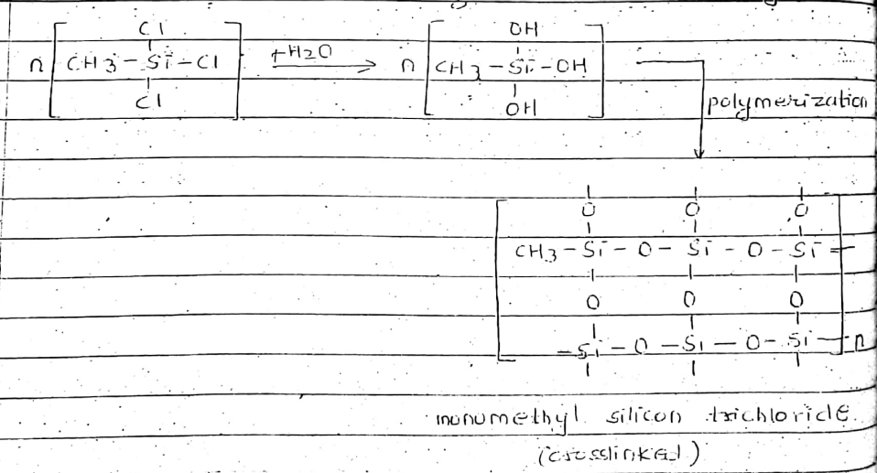
3. Silicones or Silicone Polymer
i) Monomethyl silicon trichloride – CH₃SiCl₂
It is trifunctional and gives cross-linking to the final polymer.

Slide 54
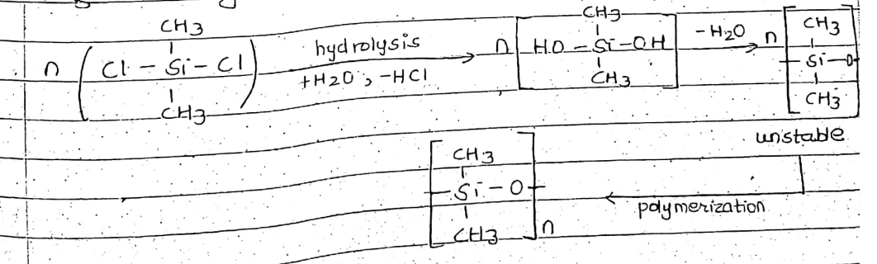
3. Silicones or Silicone Polymer
ii) Dimethyl silicon dichloride (CH₃) ₂SiCl₂
It is a bifunctional unit particle.
After polymerization, it gives a long-chain polymer.
It is also called as silicon rubber.

Slide 55
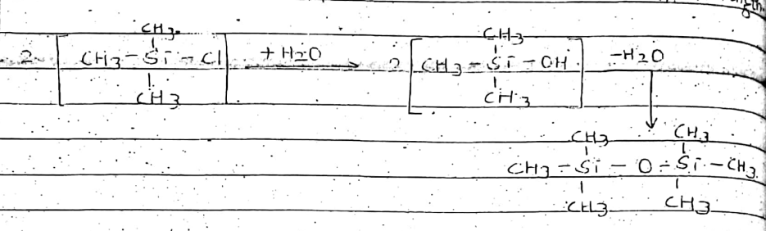
3. Silicones or Silicone Polymer
iii) Trimethyl silicon chloride (CH₃) ₃SiCl: It is a monofunctional polymer. Hence, it is called a chain stopper. It has a limited chain.

Slide 56
3. Silicones or Silicone Polymer
Uses of different types of silicone polymers:
Silicon oils/ liquid silicone polymer
Generally, they are dimethyl silicone polymers having low molecular weight. The silicon possesses low surface tension, a very small change in viscosity, etc.
Uses
Used as high-temperature lubricants as they are highly stable and non-volatile.
Used as a cosmetic and polishes.
Used as heat transfer
Used in high vacuum pump.

Slide 57
3. Silicones or Silicone Polymer
2. Silicon grease
They are made by adding carbon black, silica, wood flour, marble flour, china clay to silicone oil. They are a modified form of silicon oil.
Uses
They are used as lubricants in airplanes
They don’t freeze at low temperature (-40 ˚C) and don’t melt upto 200 ˚C. So, silicone is used in cold as well as hot circumstances.

Slide 58
3. Silicones or Silicone Polymer
3. Solid Silicon
They are highly cross-linked polymers obtained by condensing bifunctional silicon polymer or trifunctional silicon polymer.
Uses
They are used for making high-temperature insulating materials and high voltage insulating materials.
They are mixed with paints, pigment, and enamel to make them resistant to the effect of high temperature, sunlight and chemicals.

Slide 59
3. Silicones or Silicone Polymer
4. Silicon rubber
They are obtained by mixing high molecular weight of dimethyl silicone polymer, silica, carbon black/metal, etc. which causes the formation of cross-linked between methyl group of adjacent chain.
Uses
They are used in ceiling joints of aircraft and insulating electrical parts like transistors which cant be heated.

Slide 60
3. Silicones or Silicone Polymer
Properties of Silicone:
High range of thermal stability (100 ˚C -200 ˚C)
Repel water
Resistance to oxygen, ozone, UV rays, etc
Low chemical reactivity
Low ionicity
Don’t support microbiological growth.

